Slide 1








GOLD PRICE PREDICTION

Slide 2

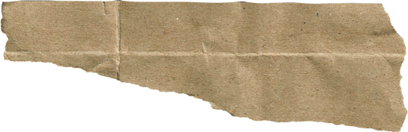



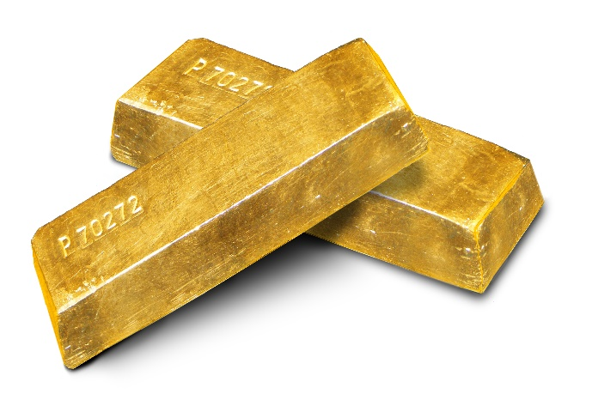






Presented By:
Malak Al-Kazem

Slide 3




Project Outline
Introduction
Datasets Sources
Regression Models
1
2
3
4
5
Using Kaggle
Using Yahoo Finance

Slide 4


Introduction
Machine learning techniques to analyze historical gold price data, economic indicators, market trends, and other relevant factors to create predictive models.
These models aim to forecast future gold prices, providing insights for investors, traders, financial analysts, and policymakers.

Slide 5






Datasets Sources
Yahoo Finance.
Sklearn dataset
ALPHA VANTAGE
Kaggle

Slide 6
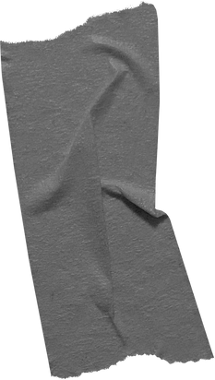
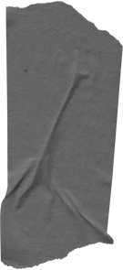
Yahoo Finance
Yahoo Finance utilizes data-driven algorithms and analytical methods within its platform, focusing on processing financial data.
Specifically tailored to provide precise and detailed information on stock market and financial market data.
And here is the link to access Yahoo Finance for detailed stock yahooFinance

Slide 7
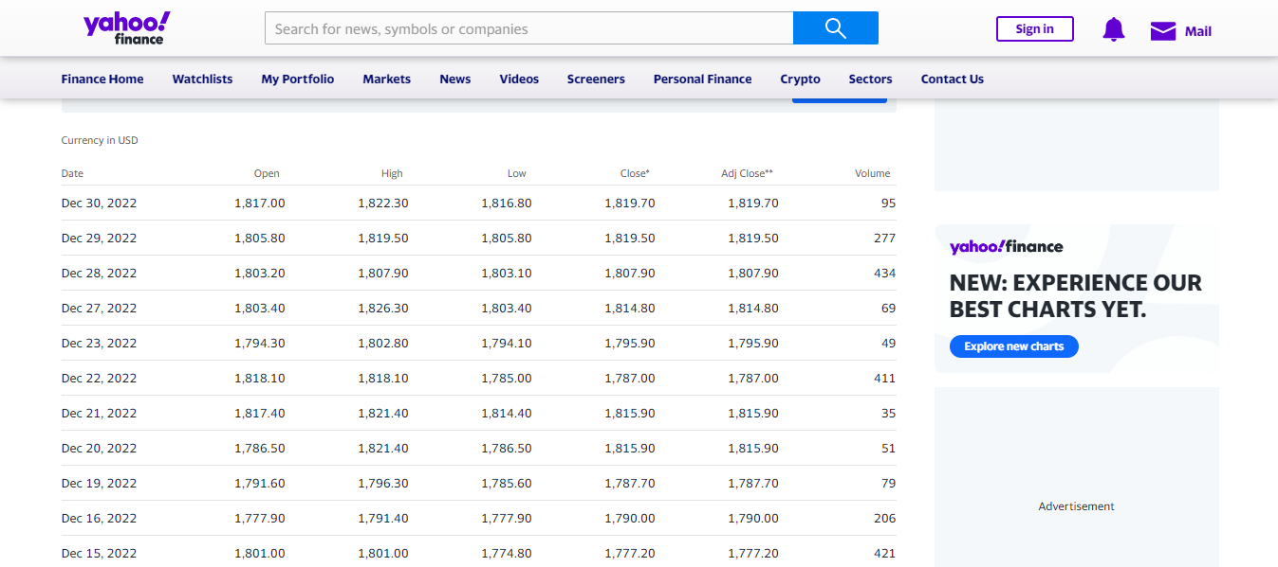

Slide 8


Kaggle Dataset
Kaggle is a popular online platform for data science machine learning .
It hosts competition , dataset , and tutorial where data scientists , researcher , and practitioner can callobrate , explore , and showcase their skills solving real-world problems using data-driven approaches .
KaggleDatasets

Slide 9
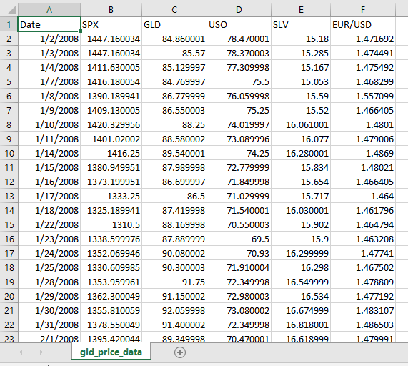

Slide 10

Regression Models
Linear Regression Linear regression models the relationship between the dependent variable (gold price) and one or more independent variables (features) by fitting a linear equation to the observed data. Random Forest Regression Random Forest Regression is an ensemble learning method that combines the predictions of multiple decision trees, providing a more robust and accurate prediction by reducing overfitting. Decision Tree Regression Decision Tree regression models predict gold prices by recursively partitioning the feature space into regions and assigning an average gold price to each region. It is a tree-like model that makes decisions based on the values of input features. K-Nearest Neighbors (KNN) Regression KNN regression predicts the gold price based on the average of the gold prices of its k-nearest neighbors in the feature space. It is a non-parametric algorithm that considers the similarity of data points to make predictions.

Slide 11
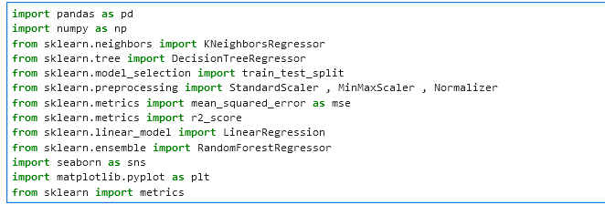
Importing Libraries

Slide 12
PART1: Using Kaggle dataset
SPX (S&P 500): SPX refers to the S&P 500, a stock market index that measures the performance of 500 large companies listed on stock exchanges in the United States, providing insight into the overall health of the stock market. GLD: GLD is the ticker symbol for the SPDR Gold Shares, an exchange-traded fund (ETF) that tracks the price of gold, making it a convenient way for investors to gain exposure to gold without physically owning the metal. USO: USO represents the United States Oil Fund, an ETF that aims to track the daily price movements of West Texas Intermediate (WTI) light, sweet crude oil, providing an indicator for oil market trends. SLV: SLV is the ticker symbol for the iShares Silver Trust, an ETF that reflects the performance of silver, allowing investors to participate in silver price movements without directly owning physical silver. EUR/USD: EUR/USD is a currency pair representing the exchange rate between the Euro (EUR) and the United States Dollar (USD), indicating how much one euro can be exchanged for in U.S. dollars, influencing gold prices as currency values impact commodity markets.

Slide 13
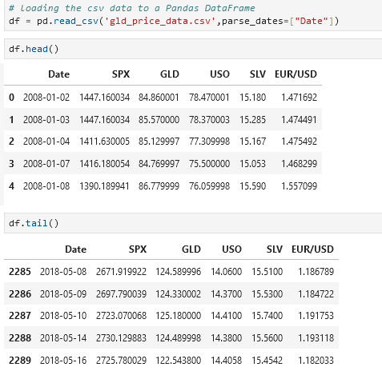
Exploratory Data Analysis

Slide 14
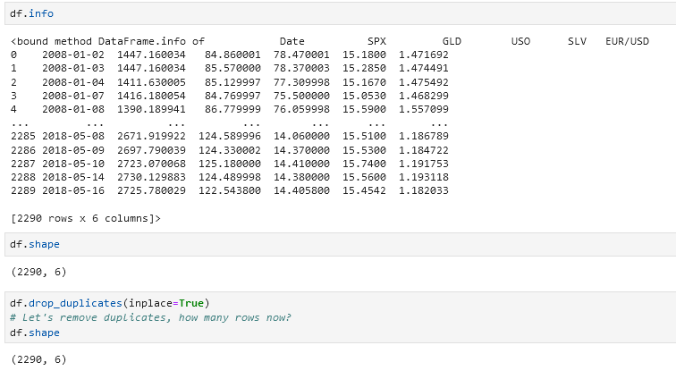
Exploratory Data Analysis

Slide 15
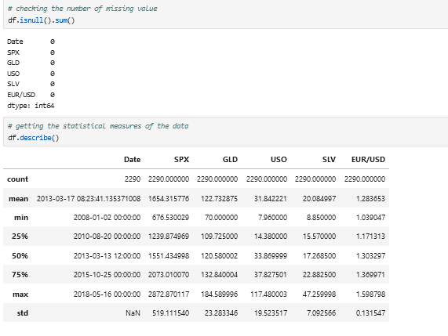
Exploratory Data Analysis

Slide 16
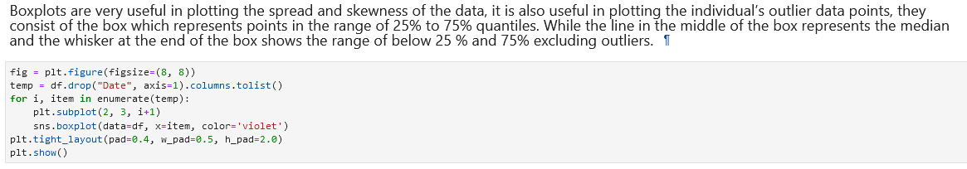
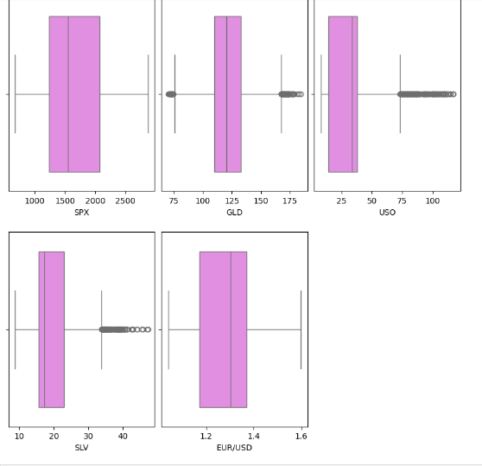
Exploratory Data Analysis

Slide 17
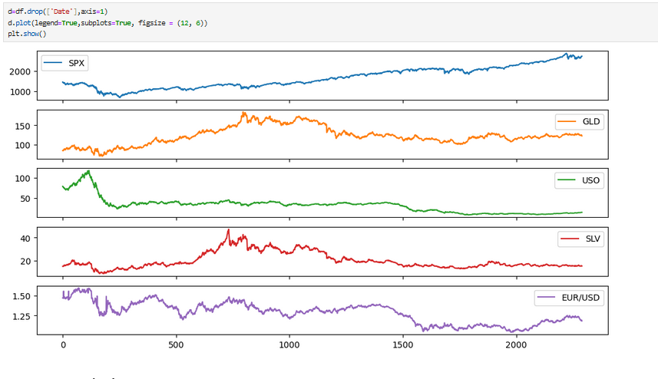

Slide 18
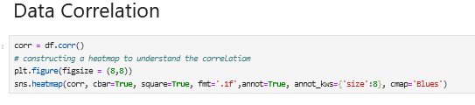
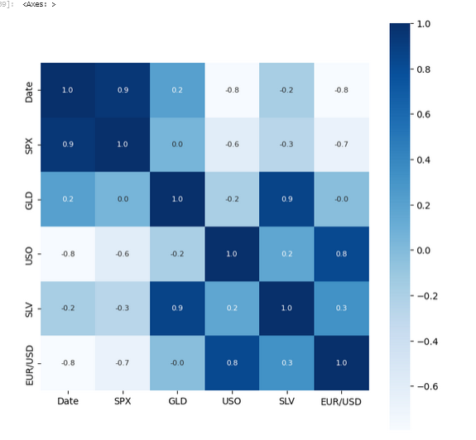


Slide 19
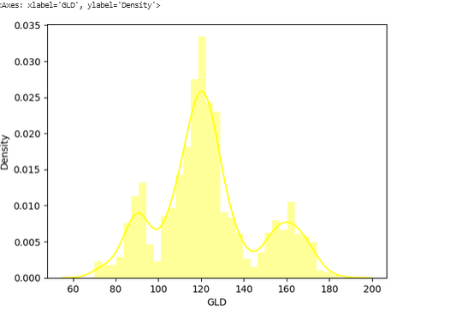
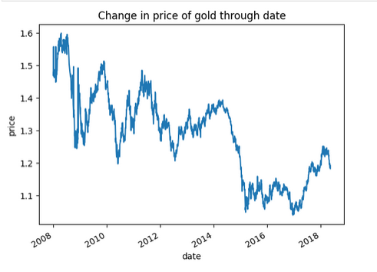

Slide 20

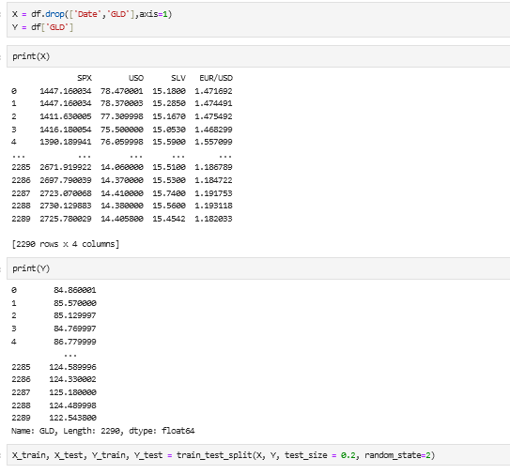
Train and Test The Data

Slide 21
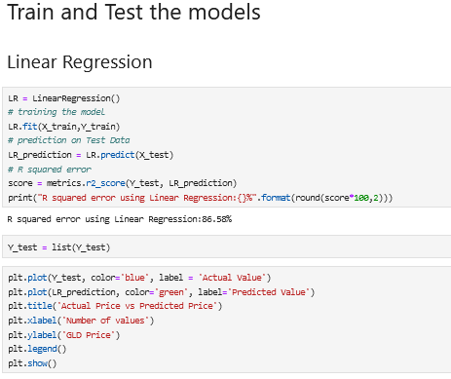
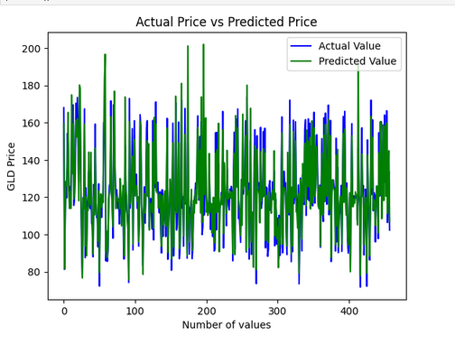
Linear Regression(86.58%)

Slide 22
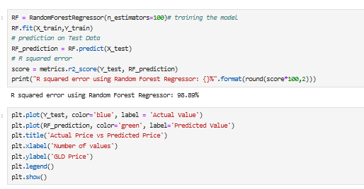
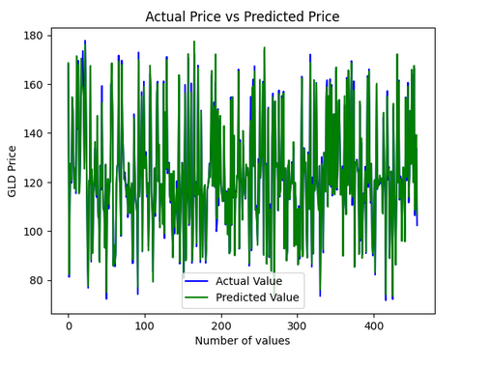
Random Forest Regression(98.89%)

Slide 23
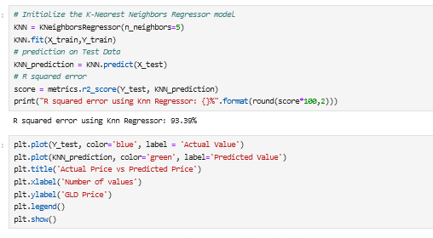
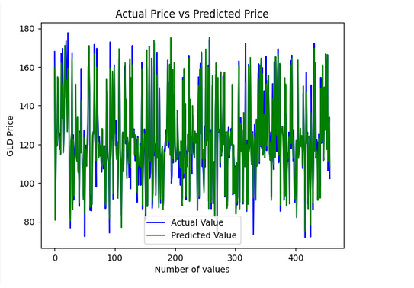
KNN-Regression(93.39%)

Slide 24
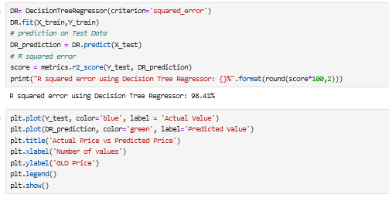
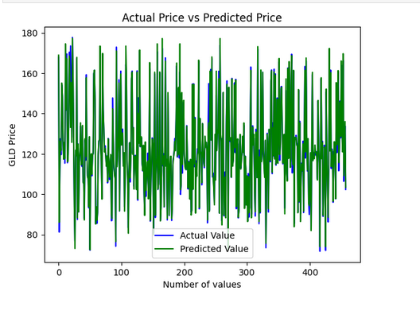
Decision Tree Regression(98.41%)

Slide 25
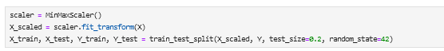
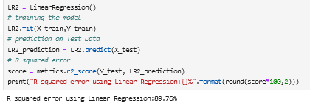
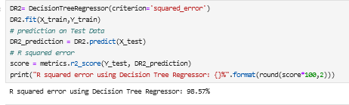
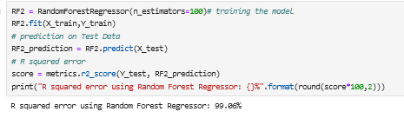
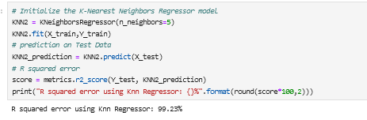
USE MIN MAX SCALER

Slide 26
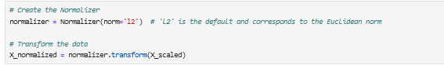
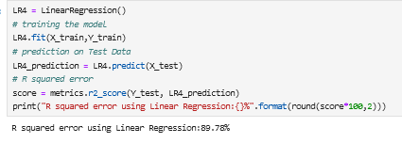
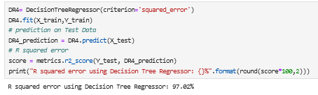
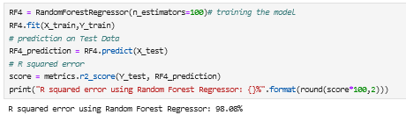
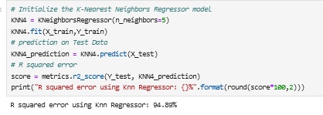
USING NORMALIZATION

Slide 27
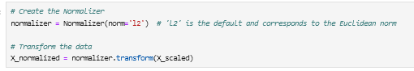
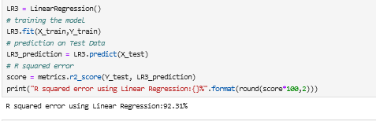
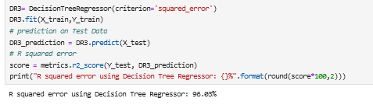
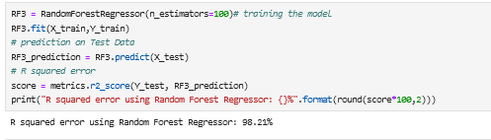
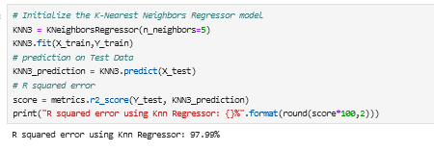
Normalization and MinMaxScaler

Slide 28

Final Results
DataCleaning
MinMaxScaler
Normalization
MinMaxScaler+Nomralization
LR:86.58
LR:89.76
LR:89.78
LR:92.31
Knn:93.39
Knn:99.23
Knn:94.89
Knn:97.99
RF:98.89
RF:99.06
RF:98.08
RF:98.21
DT:98.41
DT:98.57
DT:97.02
DT:96.03

Slide 29
PART2: Using Yahoo Finance
Open: Definition: The opening price is the value of gold at the beginning of a trading period.
In Simple Words: It's how much gold is worth when trading starts. High: Definition: The high price represents the highest value that gold reached during a specific trading period.
In Simple Words: It shows the peak value that gold reached in a given time.. Low: Definition: The low price is the lowest value that gold dropped to during a particular trading period.
In Simple Words: It indicates the lowest point gold reached within a specified time frame. Close: Definition: The closing price is the value of gold at the end of a trading period.
In Simple Words: It's how much gold is worth when trading concludes. Adj Close (Adjusted Close): Definition: The adjusted closing price accounts for events such as dividends or stock splits, providing a more accurate representation of gold's value.
In Simple Words: It's the closing price adjusted for certain changes to give a clearer picture of gold's value. Volume:
Definition: Volume represents the total amount of gold traded during a specific time period.
In Simple Words: It shows how much gold was bought or sold in a given timeframe, indicating market activity.

Slide 30
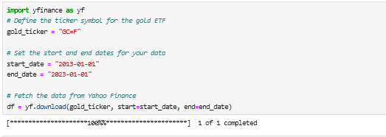
Importing Yahoo DataSet

Slide 31
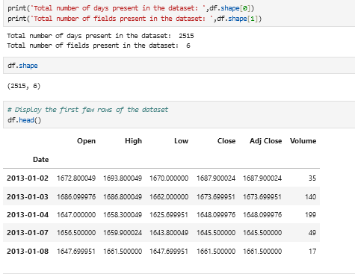
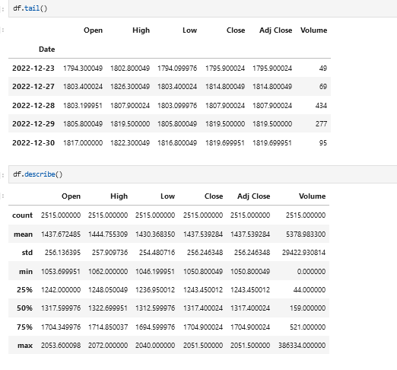
EDA

Slide 32
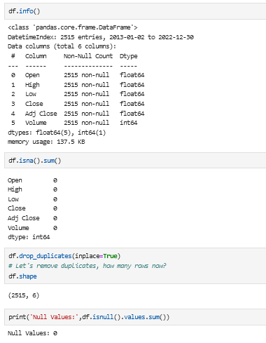
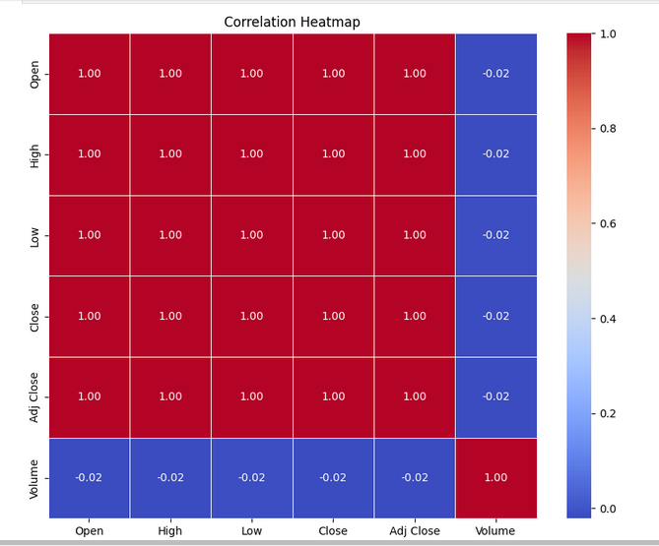
EDA

Slide 33
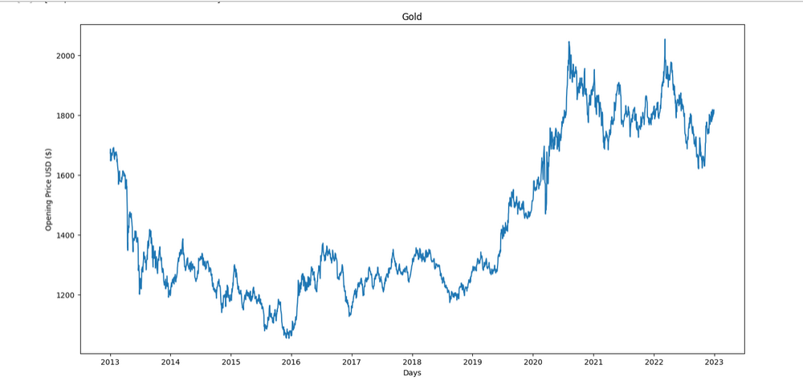
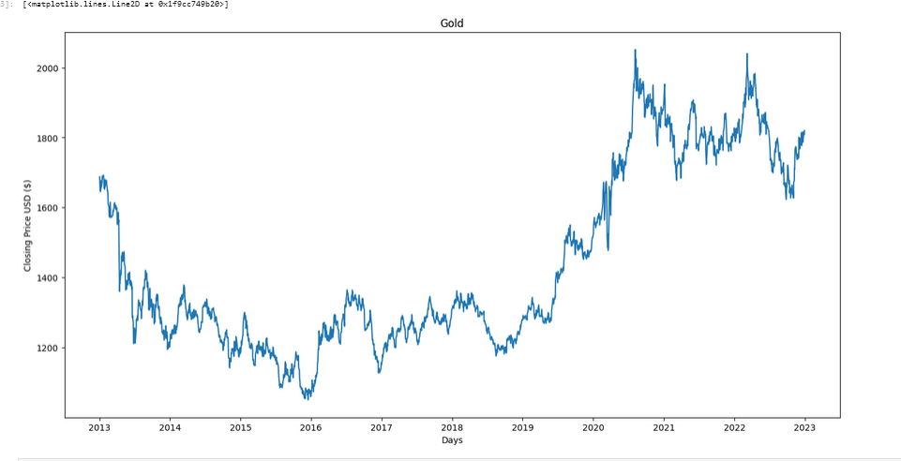
Plotting Gold Prices

Slide 34
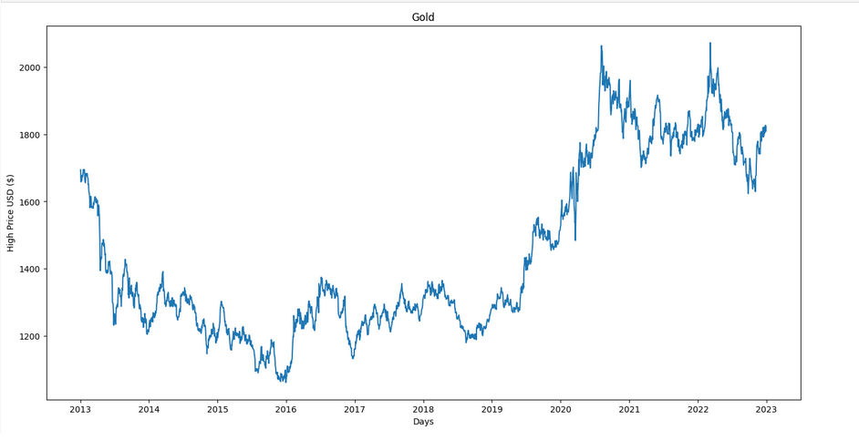
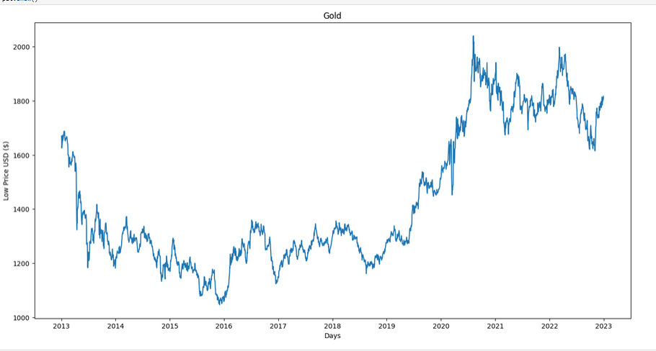
Plotting Gold Prices

Slide 35

Plotting Gold Prices

Slide 36

Plotting Features

Slide 37


Train Test Split
Test LR MODEL

Slide 38
Accuracy = 100%
OVERFITTING

Slide 39

Checking the Data again
It shows that we have to drop the volume column from the features

Slide 40



Drop Volume and use MinMaxScaler

Slide 41

Test It Again
Accuracy = 100%
OVERFITTING

Slide 42



ADD date columns again
We have a good correlation with the year

Slide 43




Select the features again and use MinMax Scaler
Accuracy is Now 99.96%

Slide 44


Trying to use feature engineering and merge a column

Slide 45

Trying to use feature engineering and merge a column
Linear Regression:99.71%
KNN Regression:99.63%
Decision Tree Regression: 99.41%
Random Forest Regression:99.63%
It shows that there is still overfitting

Slide 46


Try to Merge another column

Slide 47
FINALLY IT WORKS ☺
Before
After
Linear Regression:99.71%
KNN Regression:99.63%
Decision Tree Regression: 99.41%
Random Forest Regression:99.63%
Linear Regression:64.11%
KNN Regression:78.87%
Decision Tree Regression: 78.09%
Random Forest Regression:87.37%

Slide 48



Conclusion
"In conclusion, machine learning offers exciting possibilities across different areas. Our project highlights the value of using smart algorithms and data to make predictions. While challenges exist, the ongoing progress in technology holds promise for improved solutions. As we move forward, responsible and ethical use of machine learning is key to maximizing its benefits for society."

Slide 49




Thank You

